Slide 1
UVS Team 1

Slide 2
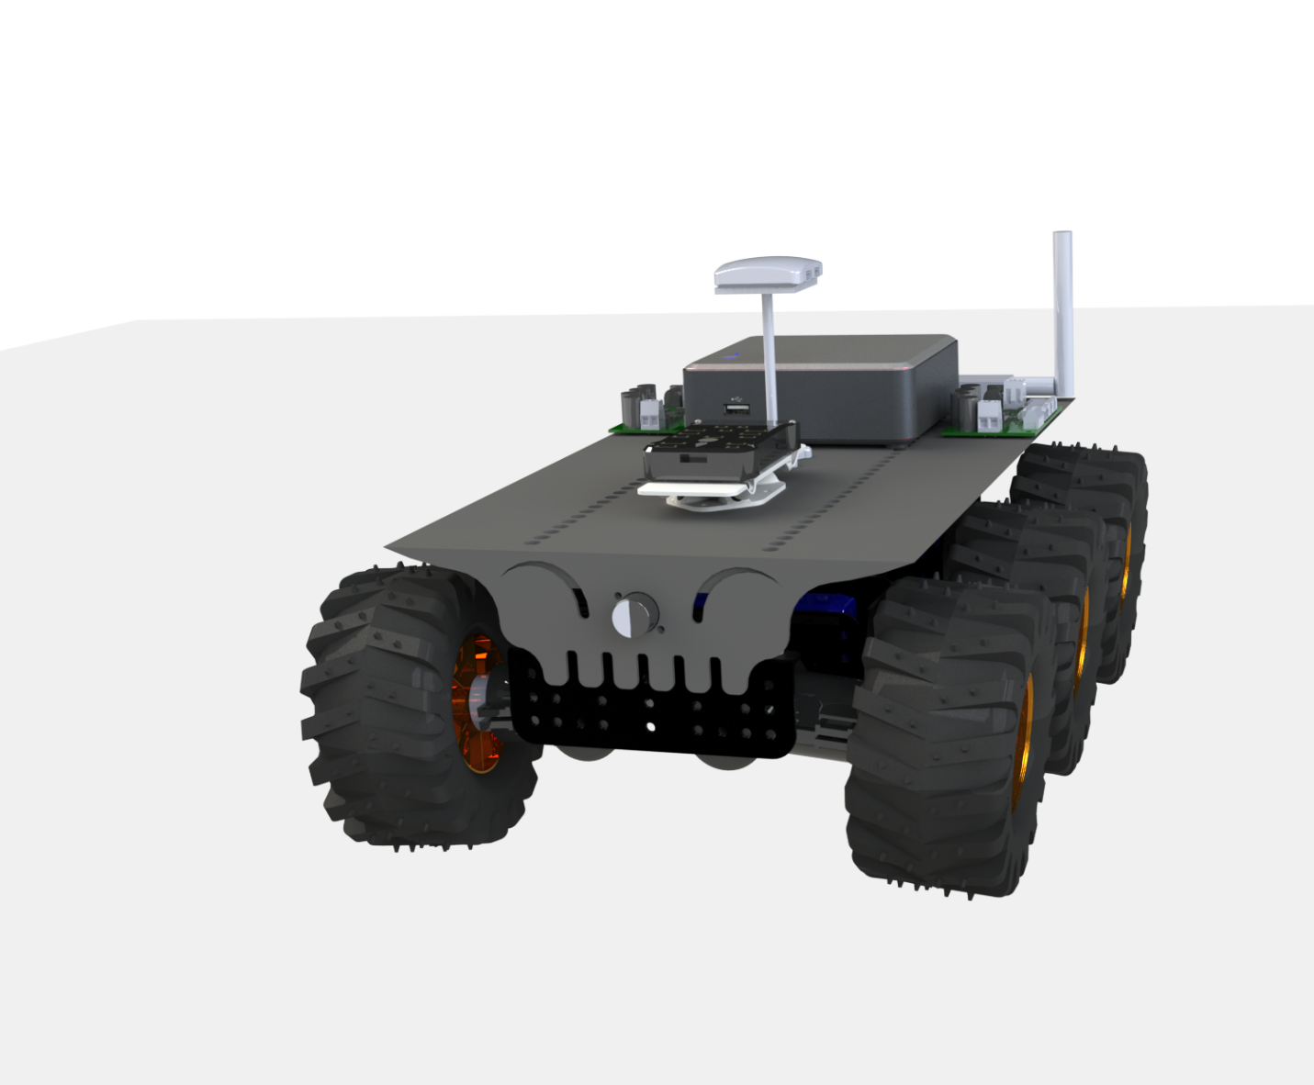
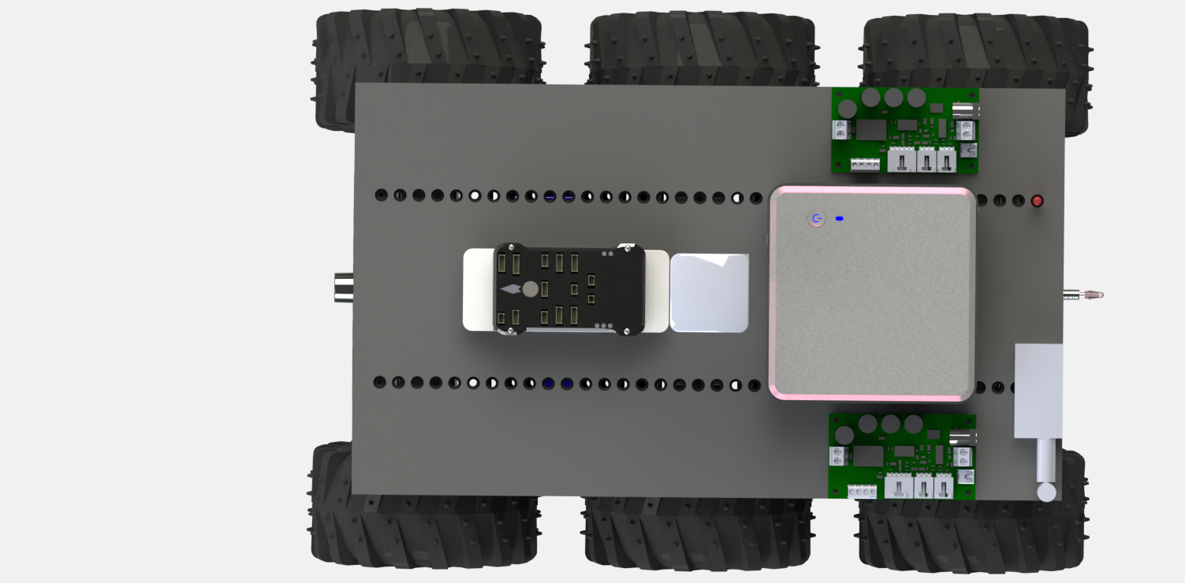
CAD MODEL

Slide 3
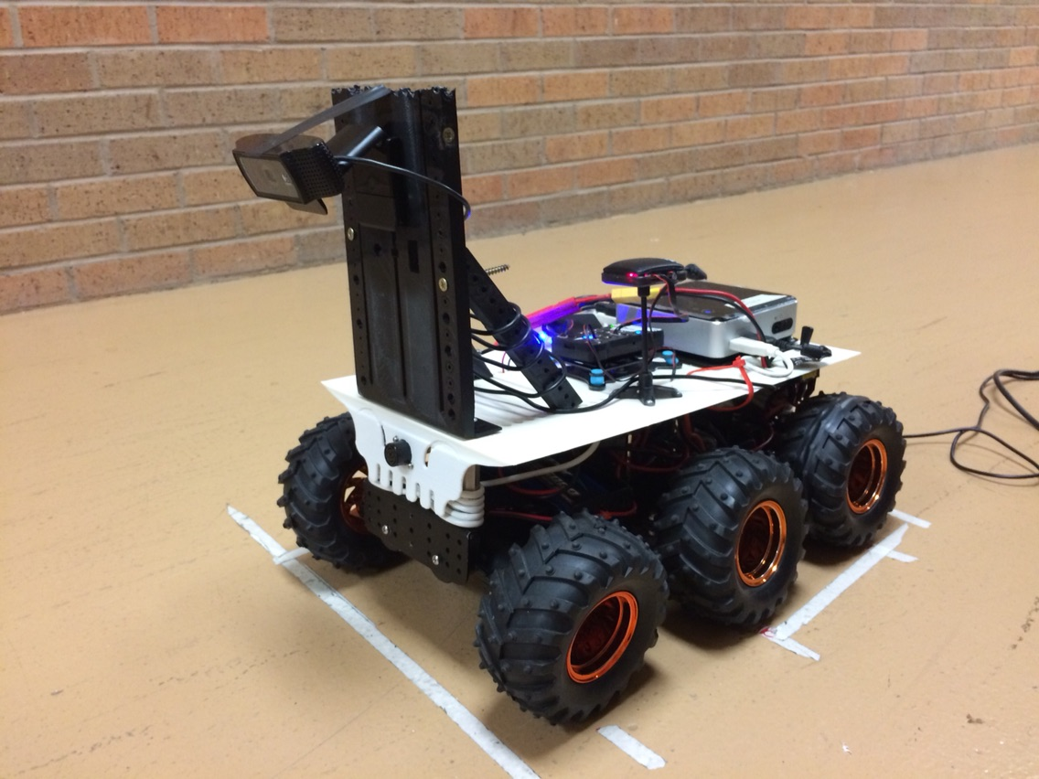
Platform With Camera Mount
Camera Height from the Platform=17.5 cm(from base of platform)

Slide 4
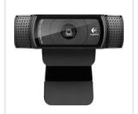
Experiment1
Resolution-320 by 240 pixels
Camera Angle – 36 degree
sees
Maximum Distance=81.28 cm
Minimum Distance=20.32 cm(blind spot)
Observation: Processed Slow
240
320

Slide 5
Experiment N
Camera Angle – 21.5 degree
Resolution-160 by 90 pixels
sees
Maximum Distance=208.28 cm
Minimum Distance=25.4 cm
90
160

Slide 6
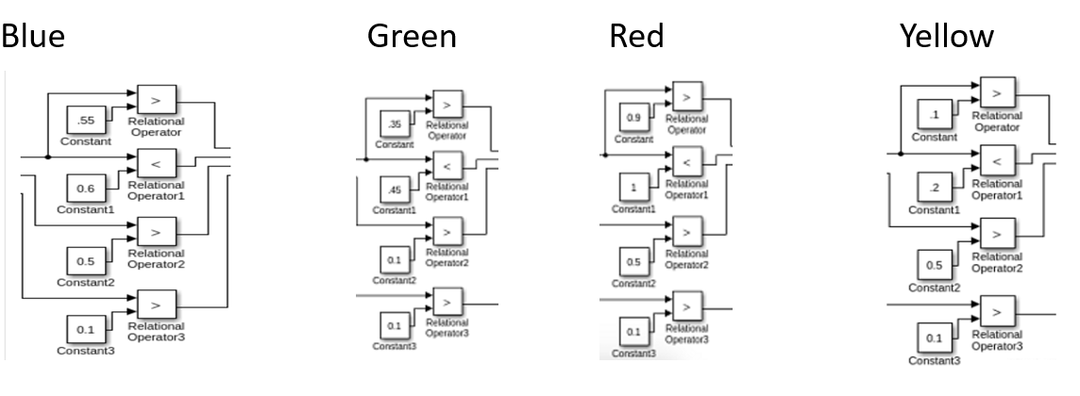
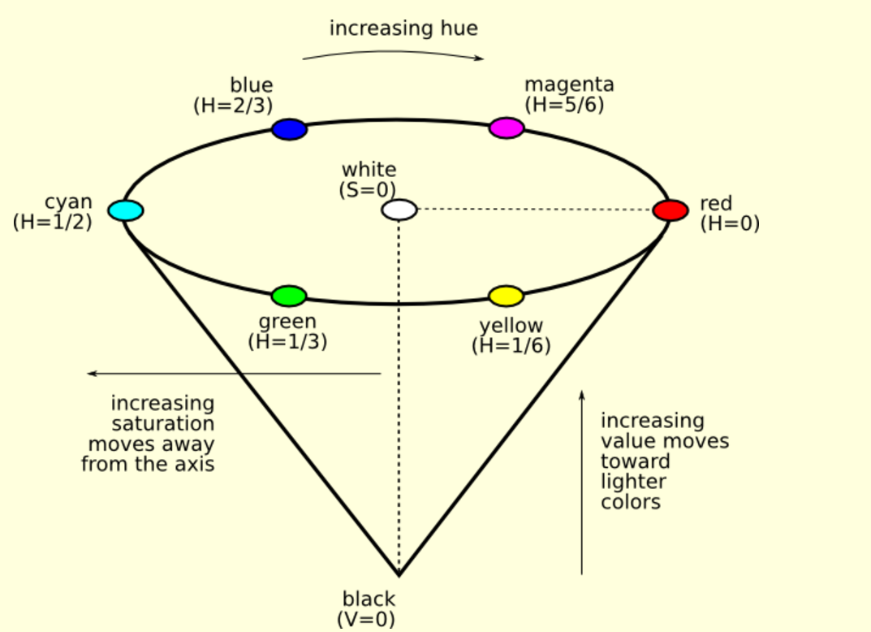
Operators Value

Slide 7
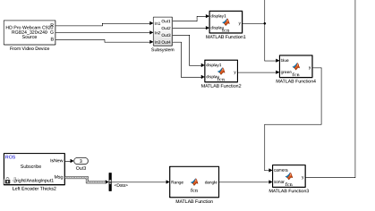
Simulink

Slide 8
Thank YOU !

